Slide 1
Baseball Pitcher’s performance prediction
Swaroop Malina

Slide 2
AGENDA
Primary goal
Dataset​
​Preprocessing
Feature selection
Model Building
​Conclusion

Slide 3
PRIMARY GOAL
There are a lot of good players in baseball, and it is often the job of baseball teams’ data analysts to give their best predictions on who can produce the best results for the team in the coming year. Every year, these decisions play a significant role in the teams' selection of players for the upcoming season. The goal of this project is to make use of the stats and conditions available and build a model to a make such predictions as accurate as possible.

Slide 4
Dataset
Rk | Name | Age | Tm | ERA | G | GS | GF | CG | SV
1 | Cory Abbott | 26 | WSN | 5.25 | 16 | 9 | 7 | 0 | 0
2 | Albert Abreu | 26 | TOT | 3.26 | 33 | 0 | 11 | 0 | 0
3 | Albert Abreu | 26 | TEX | 3.12 | 7 | 0 | 0 | 0 | 0
4 | Albert Abreu | 26 | KCR | 4.15 | 4 | 0 | 3 | 0 | 0
5 | Albert Abreu | 26 | NYY | 3.16 | 22 | 0 | 8 | 0 | 0
6 | Bryan Abreu | 25 | HOU | 1.94 | 55 | 0 | 18 | 0 | 2
7 | Domingo Acevedo | 28 | OAK | 3.33 | 70 | 0 | 12 | 0 | 4
1068 rows and 35 columns

Slide 5
Preprocessing
Redundant stats which are a combination of 2 or more stats were removed.
Tuples were grouped based on the name of the player and averaged.
Removed the stats of the pitchers who pitched less than 9 innings (1 match)
Score = (9*(SO/IP)) / (FIP + ERA)
SO: Strikeouts
IP: Innings pitched
FIP: Fielding independent pitching
ERA: 9 * ER / IP
The dataset was then split into train and test sets with 66-34 percentage split.
649 rows and 16 columns

Slide 6
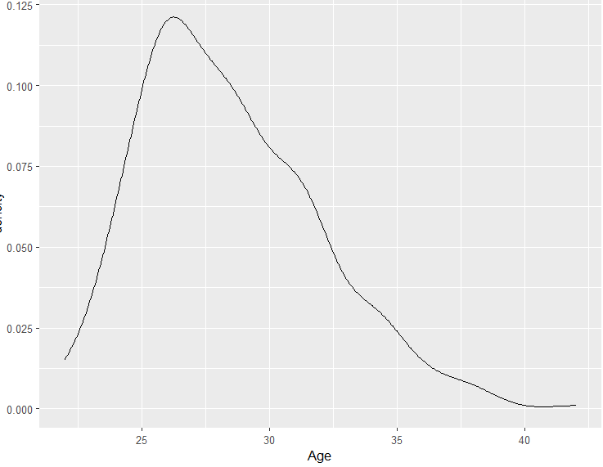
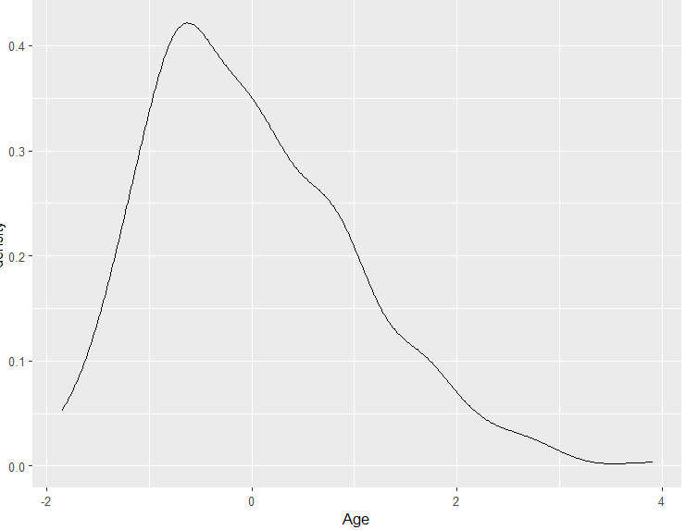
Preprocessing
Finally, both train and test set were standardized

Slide 7
FEATURE SELECTION
score ~Age+G+GS+GF+CG+IBB+IP+BF+SHO+SV+H+R+ER+BK+WP
Global F-test: Model is significant.
95% confidence.
F-test on each estimate of each feature: Age, G, GF, IBB, BF, SHO, SV, H, R are significant.
T-test on each estimate of each feature: GS, CG, IP, H are significant.

Slide 8
MODEL BUILDING
f-test features
poly with interaction
Degree 1:2
t-test features
poly without interaction
Degree 1:5
all features
21 models were trained
L2 and L1 Regularization – 6 models

Slide 9
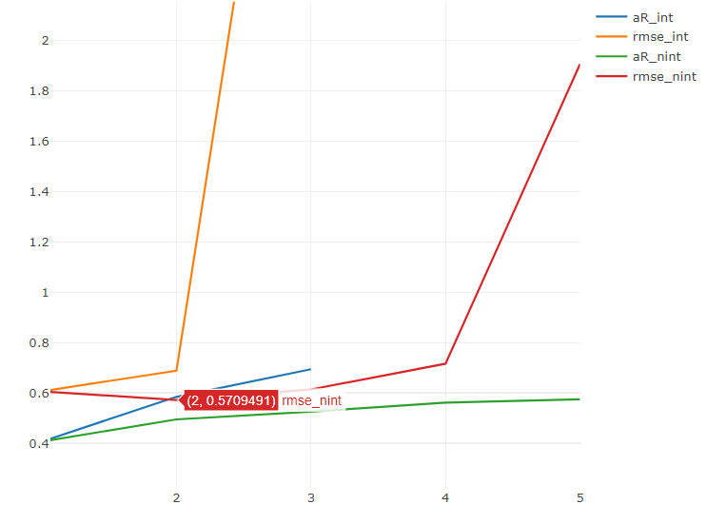
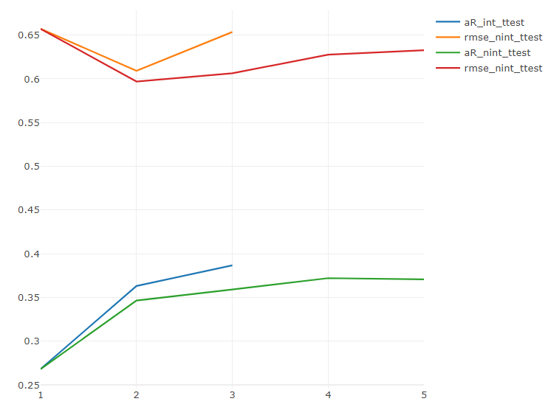
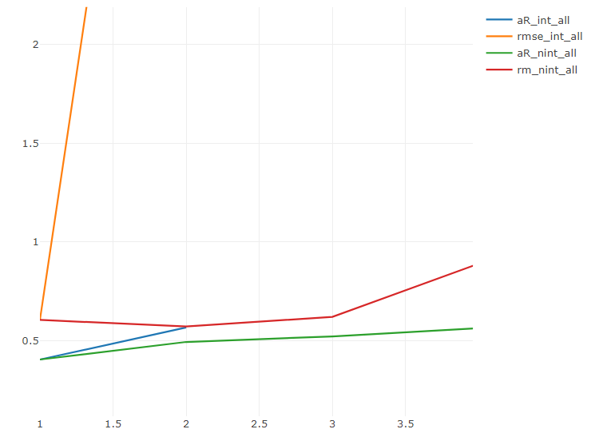

Slide 10
SUMMARY
In conclusion, stats and conditions such as age, games played, games finished, intentional bases on balls, batters faced, shutouts, saves, hits allowed, and runs allowed play an important role in predicting the performance of a pitcher.
A statistical model of order 2 with the aforementioned features can be used to predict how well a pitcher will perform, assisting team management in the purchase of a pitcher. Also, there’s 95% confidence that the model’s prediction lies within a certain range around the prediction made.
Various models have been trained and tested on the test set, and the best model is the one that produced the least error when tested on the test set.
Best model has RMSE = 0.57 and adj R-squared = 0.58.

Slide 11
THANK YOU

